Slide 1
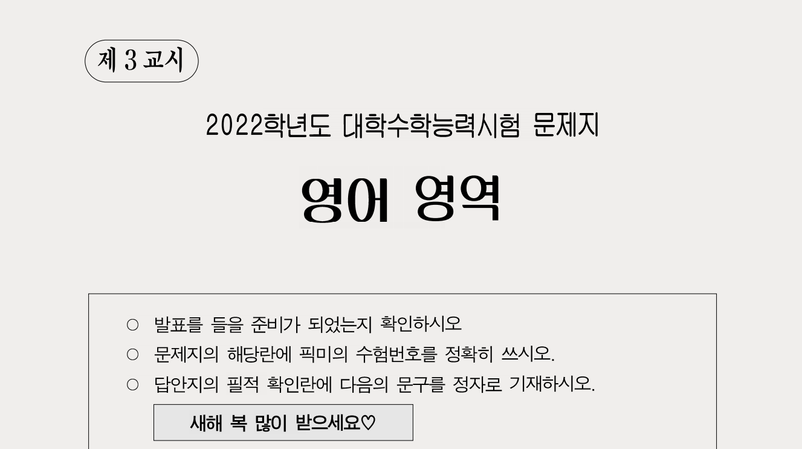
수능영어 풀이봇
픽미(PICK ME)
Mid-Project
1반 3팀
고수진 김수희 오종민
이세준 허정은
LIKELION_AI

Slide 2

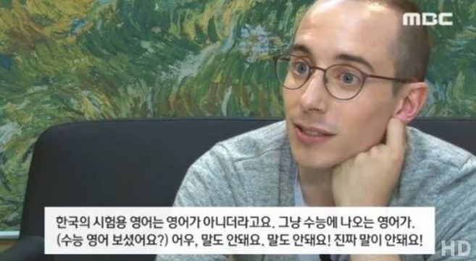
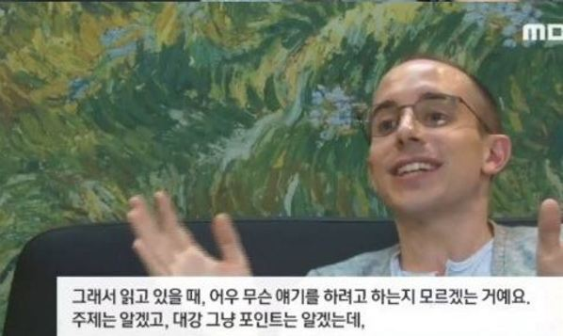
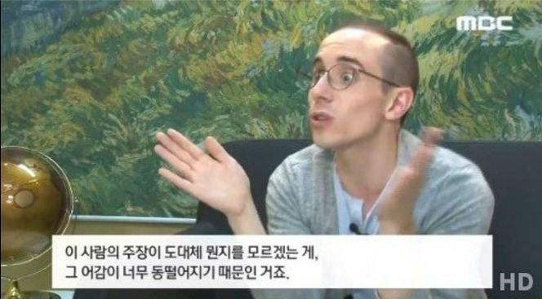
어떤 주제로 정할까?
수능 영어영역 지문

Slide 3
어떤 주제로 정할까?
수능 영어영역 지문

Slide 4
어떤 주제로 정할까?
수능영어 지문을 자연어처리하여 주제/제목/요지찾기 문제를 풀어보자

Slide 5

1.Data:
수능영어지문
주장/제목/요지문제
2.How:
자연어처리
3.Goal:
5지선다 맞추기

Slide 6
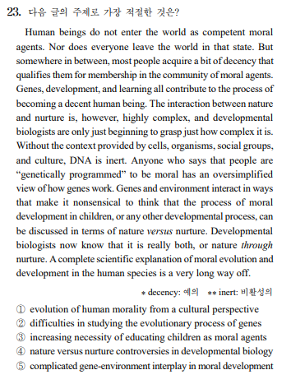
사용한 Dataset

Slide 7
사용한 Dataset
94년~2020년 수능 주제/제목/요지 찾기 80문항 지문

Slide 8
text | #1 | #2 | #3 | #4 | #5 | answer
Twin sirens hide in the sea of history, tempting those seeking to understand and appreciate the past onto the reefs of misunderstanding and misinterpretation. These twin dangers are temporocentrism and ethnocentrism. Temporocentrism is the belief that your times are the best of all possible times. All other times are thus inferior. Ethnocentrism is the belief that your culture is the best of all possible cultures. All other cultures are thus inferior. Temporocentrism and ethnocentrism unite to cause individuals and cultures to judge all other individuals and cultures by the “superior” standards of their current culture. This leads to a total lack of perspective when dealing with past and / or foreign cultures and a resultant misunderstanding and misappreciation of them. Temporocentrism and ethnocentrism tempt moderns into unjustified criticisms of the peoples of the past. | distinct differences in the ways of recording history | universal features discovered in different cultures | historians’ efforts to advocate their own culture | pros and cons of two cross-cultural perspectives | beliefs that cause biased interpretations of the past | 5
Do you have the emotional state of mind to become a leader? People pay close attention to a leader’s subtle expressions of emotion through body language and facial expression. Some emotions such as enthusiasm can quickly become contagious. Others, such as depression or discouragement, can drag down the entire organization. Leaders with positive emotional states of mind are like human magnets. People naturally gravitate to them and want to follow them. Such leaders inspire enthusiasm in their organizations and attract the best people to work for them. Conversely, leaders who emit negative emotional states of mind, who are irritable and bossy, repel people and have few followers. | reasons for leaders to hide their emotions | influence of leaders’ emotional states on people | necessity for analyzing leaders’ states of mind | various ways of staying away from bad leaders | ways of strengthening emotional bonds among leaders | 2
Tourism is important for more than just vacationing. Tourism allows people from different places and cultures to come together, and then tourists and host communities learn about each other’s differences and similarities. They also learn new tastes and ways of thinking, which may lead to a better understanding between hosts and tourists. Another positive effect of tourism is the aid it provides for the survival of a society’s culture, especially the culture’s art forms. The opportunity to sell native artworks to tourists or perform folk dances for them may encourage local artists to preserve traditional art forms. For example, Fijians have developed their palm mat and shell jewelry crafts into profitable tourist businesses. They also earn additional income by performing folk dances and fire walking. | misunderstandings between hosts and tourists | various ways of creating tourism products | negative effects of cultural exchanges | disappearance of traditional cultures | cultural benefits of tourism | 5
Many disciplines are better learned by entering into the doing than by mere abstract study. This is often the case with the most abstract as well as the seemingly more practical disciplines. For example, within the philosophical disciplines, logic must be learned through the use of examples and actual problem solving. Only after some time and struggle does the student begin to develop the insights and intuitions that enable him to see the centrality and relevance of this mode of thinking. This learning by doing is essential in many of the sciences. For instance, only after a good deal of observation do the sparks in the bubble chamber become recognizable as the specific movements of identifiable particles. | history of science education | limitations of learning strategies | importance of learning by doing | effects of intuition on scientific discoveries | difference between philosophy and science | 3
The most normal and competent child encounters what seem like insurmountable problems in living. But by playing them out, he may become able to cope with them in a step-by-step process. He often does so in symbolic ways that are hard for even him to understand, as he is reacting to inner processes whose origin may be buried deep in his unconscious. This may result in play that makes little sense to us at the moment, since we do not know the purposes it serves. When there is no immediate danger, it is usually best to approve of the child's play without interfering. Efforts to assist him in his struggles, while well intentioned, may divert him from seeking and eventually finding the solution that will serve him best. | dangers of playing violent games to mental health | beneficial influence of playing outdoors in childhood | children's play as problem solving with minimal intervention | necessity of intervening in disputes between siblings | parental roles in children's physical development | 3
Textiles and clothing have functions that go beyond just protecting the body. Dress and textiles alike are used as a means of nonverbal communication. Obvious examples would be the use of uniforms to communicate a particular social role and the modern white wedding dress Western cultures use to mark this rite of passage. Both types of clothing communicate important information nonverbally to the onlooker. The female wearing the white dress is about to be married and change her status and role in society. The person in the uniform has some specialized function in society, such as police officer, nurse, or soldier. Therefore, it can be said that clothing visually communicates information about group membership and functions as an identity marker. | educational functions of uniforms | ways to diversify styles of clothing | gender differences in choosing clothing | different cultural norms of Western society | nonverbal communicative functions of clothing | 5
Recently, researchers have suggested that the purpose of laughter is not just to communicate that one is in a playful state, but to actually induce this state in others as well. According to this view, the peculiar sounds of laughter have a direct effect on the listener, inducing positive emotional arousal that mirrors the emotional state of the laugher, perhaps by activating certain specialized brain circuits. In this way, laughter may serve an important biosocial function of coupling together the positive emotions of members of a group and thereby coordinating their activities. This would explain why laughter is so infectious; when we hear someone laughing, it is almost impossible not to feel cheerful and begin laughing too. | effects of laughter on others | benefits of activating brain circuits | strategies for coordinating activities | negative aspects of emotional reactions | importance of grouping in communication | 1
In order to successfully release himself from the control of his parents, a child must be secure in his parents’ power, as represented by their loving authority. The more effectively they communicate that authority, the more secure the child feels, and the better able he is to move away from them toward a life of his own. During this lengthy process, whenever he feels threatened, he turns back toward the safety of his parents’ love and authority. In other words, it is impossible for a child to successfully release himself unless he knows exactly where his parents stand, both literally and figuratively. That requires, of course, that his parents know where they themselves stand. If they don’t know where they stand ― if, in other words, they are insecure in their authority ― they cannot communicate security to their child, and he cannot move successfully away from them. Under the circumstances, he will become clingy, or disobedient, or both. | necessity of parental intervention in ensuring children’s safety | roles of parental authority in children’s social skills development | consequences of offering parental supervision for children’s independence | requirements for preventing children from being disobedient to their parents | importance of communicating parental authority to children for their independence | 5
Even when scientists are able to identify seemingly beneficial nutrients, they cannot always understand how those nutrients will operate in a real-life context, in the course of our daily meals. Fruits and vegetables are believed to help prevent cancer. Scientists have believed that it is the antioxidants in these foods that make the difference — compounds like beta carotene, lycopene, and vitamin E. Yet when these molecules were extracted from fruits and vegetables and made into supplements, they did not reduce cancer. The beta carotene supplement actually increased the risk of certain cancers. In other words, scientists thoroughly misunderstood the causes of complex events. They identified one element engaged in the process of nutrition without fully comprehending how the system as a whole truly functions. Nutritional scientists —pursuing the hot paradigm of isolating nutrients — failed to see a multitude of links in the complex chain that leads to good health. | problems of making nutritional supplements out of plants | needs for an alternative scientific method for isolating nutrients | insufficient understanding of how nutrients work in the whole system | potential benefits of extracting molecules from fruits and vegetables | challenge of finding beneficial nutrients that may help prevent cancers | 3
In the nineteenth century, a decisive moment occurred when people in advertising and journalism discovered that if they framed their stories and appeals with fear, they could capture our attention. It is an emotion we find hard to resist or control, and so they constantly shifted our focus to new possible sources of anxiety: the latest health scare, the new crime wave, and endless hazards in the environment of which we were not aware. With the increasing sophistication of the media and the haunting quality of the imagery, they have been able to give us the feeling that we are fragile creatures in an environment full of danger ― even though we live in a world infinitely safer and more predictable than anything our ancestors knew. With their help, our anxieties have only increased. | the crisis of modern journalism | the various sources of human fears | the media’s exploitation of human anxieties | the importance of advertising and journalism | the fragile nature of human life in modern society | 3
Why is it difficult to find a runner who competes equally well in both 100-m and 10,000-m races? The primary reason is that our muscles contain two main types of muscle fibers, called slow and fast muscle fibers. Slow muscle fibers are muscle cells that can sustain repeated contractions but don't generate a lot of quick power for the body. They perform better in endurance exercises, like long-distance running, which require slow, steady muscle activity. Fast muscle fibers are cells that can contract more quickly and powerfully than slow muscle fibers but fatigue much more easily; they function best for short bursts of intense activity, like weight lifting or sprinting. | reasons for runners to develop strong muscles | differences between slow and fast muscle fibers | comparison of sprinting with long-distance running | necessity of building muscles for long-distance runners | relationship between muscle fibers and physical fatigue | 2
Scientists should be careful to reduce bias in their experiments. A bias occurs when what the scientist expects changes how the results are viewed. This expectation might cause a scientist to select a result from one trial over those from other trials. Scientists can lessen bias by running as many trials as possible and by keeping accurate notes of each observation made. Valid experiments also must have data that are measurable. This allows others to compare the results to data they obtain from a similar experiment. Most importantly, the experiment must be repeatable. Findings are supportable when other scientists perform the same experiment and get the same results. | necessary conditions of repeatable experiments | importance of identifying bias in scientific research | requirements for objective scientific experiments | guidelines for collecting measurable data in experiments | effective strategies for keeping accurate notes on data | 3
We sometimes encounter students who come to our offices and ask how they could have worked so hard but still failed our tests. They usually tell us that they read and reread the textbook and their class notes, and that they thought they understood everything well by the time of the exam. And they probably did internalize some bits and pieces of the material, but the illusion of knowledge led them to confuse the familiarity they had gained from repeated exposure to the concepts in the course with an actual understanding of them. As a rule, reading text over and over again yields diminishing returns in actual knowledge, but it increases familiarity and fosters a false sense of understanding. Only by testing ourselves can we actually determine whether or not we really understand. That is one reason why teachers give tests, and why the best tests probe knowledge at a deep level. | positive impact of student counseling on study skills | importance of familiarity in gaining actual understanding | relationship between reading and gaining high test scores | tests as a means to distinguish real understanding from familiarity | necessity of internalizing reading materials to improve test scores | 4
Hundreds of species of small fishes exist in well-defined social organizations called schools. Fish schools vary in size from a few individuals to enormous populations extending over several square kilometers. Schools usually consist of a single species, with all members similar in size or age. For small animals with no other means of individual defense, schooling behavior provides a degree of protection. Predatory fishes have less chance of encountering prey if the prey are members of a school because the individuals of the prey species are concentrated in compact units rather than dispersed over a much larger area. Moreover, once a predator encounters a school, satiation of the predator enables most members of the school to escape unharmed. Large numbers of fishes in a school may achieve additional survival advantages by confusing predators with continually shifting and changing positions; they might even discourage hungry predators with the illusion of an impressively large and formidable opponent. | protective instincts of small fish species | origin of social organizations in small fishes | fish schooling as a behavioral strategy for survival | necessity of fish farms to save endangered species | behavioral differences between predatory fishes and prey | 3
What everyday rules for behavior guide parents’ efforts to socialize their toddlers and preschool-age children? To answer this question, Gralinski and Kopp observed and interviewed mothers and their children in these age groups. They found that for fifteen-month-olds, mothers’ rules and requests centered on ensuring the children’s safety and, to a lesser extent, protecting the families’ possessions from harm; respecting basic social niceties (“Don’t bite”; “No kicking”); and learning to delay getting what they wanted. As children’s ages and cognitive sophistication increased, the numbers and kinds of prohibitions and requests expanded from the original focus on child protection and interpersonal issues to family routines, self-care, and other concerns regarding the child’s independence. By the time children were three, a new quality of rule emerged: “Do not scream in a restaurant, run around naked in front of company, or pick your nose.” | changes in maternal rules according to children’s age | limitations of discipline for children’s socialization | parents’ concerns about children’s independence | importance of parents’ anger management skills | effects of thinking ability on children’s socialization | 1
Ancient Greek and Roman costume is essentially draped, and presents a traditional stability and permanence. While it received certain fashions over the centuries, it never underwent any major transformation. Leon Heuzey, the pioneer of the study of classical costume, set forth with exemplary clarity its two basic principles: the first is that Classical costume has no form in itself, as it consisted of a simple rectangular piece of cloth woven in varying sizes according to its intended use and the height of the customer, without differentiation between the sexes; the second is that this cloth is always draped, never shaped or cut, and was worn round the body in accordance with definite rules. Thus it was always fluid and ‘live.’ It is notable that we find no evidence in Classical times of tailors or dressmakers: the word itself barely exists in Greek or Latin. | basic characteristics of Classical costume | significant transformations in Classical costume | the greatness of Leon Heuzey’s study of classical costume | the origin of ancient Greek and Roman costume | difficulties in defining Classical costume | 1
Living things naturally return to a state of balance. When we are disturbed by forces acting on us, our inner machinery kicks in and returns us to a balanced state of equilibrium. Homeostasis is the word we use to describe the ability of an organism to maintain internal equilibrium by adjusting its physiological processes. Most of the systems in animal and human physiology are controlled by homeostasis. We don’t like to be off balance. We tend to keep things in a stable condition. This system operates at all levels. Our blood stays the same temperature. Except for extraordinary exceptions, when people find ways to intervene using methods more powerful than our tendency to equilibrium, our habits, behaviors, thoughts, and our quality of life stay pretty much the same too. | physical balance needed for mental equilibrium | inner mechanisms to enhance the quality of life | general tendency of organisms to keep equilibrium | major differences in animal and human physiology | biological processes resulting from habitual behaviors | 3
All of us use the cultural knowledge we acquire as members of our own society to organize our perception and behavior. Most of us are also naive realists: we tend to believe our culture mirrors a reality shared by everyone. But cultures are different, and other people rarely behave or interpret experience according to our cultural plan. For example, an American anthropologist attempted to tell the classic story of Hamlet to Tiv elders in West Africa. She believed that human nature is pretty much the same the whole world over; at least the general plot and motivation of the great tragedy would always be clear. But, at each turn in the story when she told it, the Tiv interpreted the events and motives in Hamlet using their own cultural knowledge. The result was a very different version of the classic play. | cultural differences in perception and interpretation | tragic characteristics of classic West African plays | the positive function of culture as a mirror of reality | human nature and its role in developing culture | the process of acquiring cultural knowledge | 1
Some species seem to have a stronger influence than others on their ecosystem. Take away the sea stars along the northwest coast of the United States, for instance, and the ecosystem changes dramatically; in the absence of these sea stars, their favorite prey, mussels, takes over and makes it hard for other species that used to live there. Sea stars are known as keystone species, because as top predators they determine ecosystem structure by their eating habits. If you chop down an aspen tree by a beaver pond, not much will happen; but if you take away a beaver, a wetland might dry out, changing the kinds of plants that live there and the animals that rely on them. Because beavers exert their influence by physically altering the landscape, they are known as ecosystem engineers. | ways of cultivating ecosystem engineers | altering the ecosystem along the U.S. coasts | species playing a major role in the ecosystem | causes of population reduction in some species | necessity of protecting endangered species in wetlands | 3
Despite the fact that ancient civilizations relied upon the apparent motion of celestial bodies through the sky to determine seasons, months, and years, we know little about the details of timekeeping in prehistoric eras. But wherever we turn up records and artifacts, we usually discover that in every culture, some people were preoccupied with measuring the passage of time. Ice-age hunters in Europe over 20,000 years ago scratched lines and made holes in sticks and bones, possibly counting the days between phases of the moon. Five thousand years ago, Sumerians in the Tigris-Euphrates valley had a calendar that divided the year into 30 day months, and the day into 12 periods. We have no written records of Stonehenge, built over 4,000 years ago in England, but its alignments show its purposes apparently included the determination of seasonal or celestial events. | contrast in timekeeping between ancient and modern society | significance of making a calendar in human history | astronomy and the western religious rituals | measuring time in ancient civilizations | observing stars in prehistoric eras | 4
While in Japan, I ordered green tea with sugar at a restaurant. A waiter politely explained that one does not drink green tea with sugar. I responded that I was aware of this custom but I liked my tea sweet. The waiter took up the issue with the manager. After a lengthy conversation, the manager came over and said, “I’m very sorry. We don’t have sugar.” Disappointed, I changed my order to a cup of coffee, which the waiter soon brought over. Resting on the saucer were two packets of sugar. My failure to obtain a cup of sweet green tea was due to a fundamental difference in our ideas about choice. In America, a paying customer has every right to have a request met. But from a Japanese perspective, it is their duty to protect those who do not know any better. | historical perspectives on Japanese customs | difficulty of altering tea-drinking habits | various factors influencing customer preference | health benefits of drinking green tea | cultural difference in dealing with customer requests | 5
사용한 Dataset

Slide 9
어떤 모델을 사용할까?
Textrank
Word2vec
Doc2vec
Wmd
(Seq2seq + attention)
+ Machine Learning

Slide 10
어떤 모델을 사용할까?
Textrank
Word2vec
Doc2vec
Wmd
(Seq2seq + attention)
+ Machine Learning

Slide 11
어떤 모델을 사용할까?
Textrank
Word2vec
Doc2vec
Wmd
(Seq2seq + attention)
+ Machine Learning

Slide 12
어떤 모델을 사용할까?
Textrank
Word2vec
Doc2vec
Wmd
(Seq2seq + attention)
+ Machine Learning

Slide 13
어떤 모델을 사용할까?
Textrank
Word2vec
Doc2vec
Wmd
(Seq2seq + attention)
+ Machine Learning

Slide 14
전략 1 :
지문을 요약한 한 문장과 각 선지를 비교
TextRank로 지문을 한 문장으로 요약하고 그 문장과 각 선지별로 유사도를 비교,
가장 높은 유사도를 가진 지문을 정답으로 고른다.
토큰화한 요약문
['Get', 'start', 'dig', 'benefit', 'multiply', '.', 'heal', 'power', 'flowers—and', 'tree', 'fresh', 'air', 'sweet-smelling', 'soil', '.', 'walk', 'garden', 'matter', 'see', 'one', 'window', 'lower', 'blood', 'pressure', 'reduce', 'stress', 'ease', 'pain', '.']
보기1. ['ways', 'growing', 'flowers']
보기1. distance = 1.2767808544527506
보기2. ['curing', 'high', 'blood', 'pressure']
보기2. distance = 1.1608672050266047
보기3. ['healing', 'effect', 'gardening']
보기3. distance = 1.228558750464308
보기4. ['conditions', 'nursing', 'homes']
보기4. distance = 1.3076918564866575
보기5. ['trends', 'constructing', 'hospitals']
보기5. distance = 1.3256770700500087

Slide 15
전략 2 :
지문전체와 각 선지의 유사도 비교
Wmd와 word2vec으로 영어 지문 전체와 각 선지의 유사도를 비교하여,
가장 높은 유사도를 가진 지문을 정답으로 고른다.
토큰화한 본문
['knowing', 'something', 'happened', 'important.', 'understanding', 'historic', 'events', 'took', 'place', 'also', 'important.', 'this,', 'historians', 'often', 'turn', 'geography.', 'weather', 'patterns,', 'water', 'supply,', 'landscape', 'place', 'affect', 'lives', 'people', 'live', 'there.', 'example,', 'explain', 'ancient', 'egyptians', 'developed', 'successful', 'civilization,', 'must', 'look', 'geography', 'egypt.', 'egyptian', 'civilization', 'built', 'banks', 'nile', 'river,', 'flooded', 'year,', 'depositing', 'soil', 'banks.', 'rich', 'soil', 'could', 'help', 'farmers', 'grow', 'enough', 'crops', 'feed', 'people', 'cities.', 'meant', 'everyone', 'farm,', 'people', 'could', 'perform', 'jobs', 'helped', 'develop', 'civilization.']
선택지1: ['significance', 'geography', 'understanding', 'history']
이 선택지의 wmdistance는 1.2272952741574357 입니다
선택지2: ['effects', 'nile', 'river', 'egyptian', 'farming']
이 선택지의 wmdistance는 1.2180122765246166 입니다
선택지3: ['differences', 'geography', 'geology']
이 선택지의 wmdistance는 1.2825574145683871 입니다
선택지4: ['varieties', 'egyptian', 'civilization']
이 선택지의 wmdistance는 1.2455765729213704 입니다
선택지5: ['development', 'egyptian', 'culture']
이 선택지의 wmdistance는 1.2548030954974887 입니다

Slide 16
텍스트 요약에는 두가지 방법이 있다.
1) 추출적 요약
추출적 요약은 원문에서 중요한 핵심 문장 또는 단어구를 몇 개 뽑아서 이들로 구성된 요약문을 만드는 방법.
그렇기 때문에 추출적 요약의 결과로 나온 요약문의 문장이나 단어구들은 전부 원문에 있는 문장들입니다.
추출적 요약의 대표적인 알고리즘으로 머신 러닝 알고리즘인 텍스트랭크(TextRank)가 있다.
이 방법의 단점이라면, 이미 존재하는 문장이나 단어구로만 구성하므로 모델의 언어 표현 능력이 제한된다는 점.
2) 추상적 요약
추상적 요약은 원문에 없던 문장이라도 핵심 문맥을 반영한 새로운 문장을 생성해서 원문을 요약하는 방법.
마치 사람이 요약하는 것 같은 방식인데, 당연히 추출적 요약보다는 난이도가 높다.
이 방법은 주로 인공 신경망을 사용하며 대표적인 모델로 seq2seq를 사용한다.
지도학습이기 때문에 추상적 요약을 인공 신경망으로 훈련하기 위해서는 ‘원문' 뿐만 아니라 '실제 요약문'이라는
레이블 데이터가 있어야 합니다. -> 그렇기 때문에 데이터를 구성하는 것 자체가 하나의 부담.

Slide 17
텍스트 요약에는 두가지 방법이 있다.
1) 추출적 요약
추출적 요약은 원문에서 중요한 핵심 문장 또는 단어구를 몇 개 뽑아서 이들로 구성된 요약문을 만드는 방법.
그렇기 때문에 추출적 요약의 결과로 나온 요약문의 문장이나 단어구들은 전부 원문에 있는 문장들입니다.
추출적 요약의 대표적인 알고리즘으로 머신 러닝 알고리즘인 텍스트랭크(TextRank)가 있다.
이 방법의 단점이라면, 이미 존재하는 문장이나 단어구로만 구성하므로 모델의 언어 표현 능력이 제한된다는 점.
2) 추상적 요약
추상적 요약은 원문에 없던 문장이라도 핵심 문맥을 반영한 새로운 문장을 생성해서 원문을 요약하는 방법.
마치 사람이 요약하는 것 같은 방식인데, 당연히 추출적 요약보다는 난이도가 높다.
이 방법은 주로 인공 신경망을 사용하며 대표적인 모델로 seq2seq를 사용한다.
지도학습이기 때문에 추상적 요약을 인공 신경망으로 훈련하기 위해서는 ‘원문' 뿐만 아니라 '실제 요약문'이라는
레이블 데이터가 있어야 한다 -> 그렇기 때문에 데이터를 구성하는 것 자체가 하나의 부담.
* 어텐션을 이용한 텍스트 요약(추상적 요약) : https://wikidocs.net/72820

Slide 18
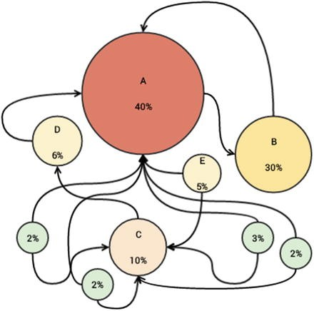
Textrank algorithm
하이퍼링크를 가진 웹 문서
Google의 PageRank Algorithm을 이용
유사도 비교를 통해 문장이나 단어에 가중치를 매겨 하나의 문서를 요약하는 알고리즘
단어는 문장 내 공동 출현 값을 가중치로, 문장은 다른 문장과의 유사도를 가중치로 매긴다.
출현 빈도가 높은 단어나 문장을 추출하는 성격의 요약 알고리즘

Slide 19
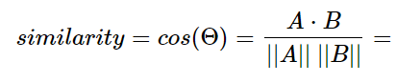
Word2vec algorithm
고양이 + 애교 = 강아지 한국 - 서울 + 도쿄 = 일본 박찬호 - 야구 + 축구 = 호나우두
저차원에 단어의 의미를 여러 차원에 분산하여 표현
0
Korea
Seoul
Dimension = # of words = 7
<One Hot Vector>
Mark = [1 0 0 0 0 0 0]
Zuckerberg = [0 1 0 0 0 0 0]
Visit = [0 0 1 0 0 0 0]
Korea = [0 0 0 1 0 0 0]
CEO = [0 0 0 0 1 0 0]
Facebook = [0 0 0 0 0 1 0]
Seoul = [0 0 0 0 0 0 1]
Mark Zuckerberg visited Korea.
The CEO of Facebook visited Seoul.
visit
Mark
CEO
[‘Mark’, ‘Zuckerberg’, ‘visit’, ‘Korea’]
[‘CEO’, ‘Facebook’, ‘visit’, ‘Seoul’]
Zuckerberg
Facebook

Slide 20
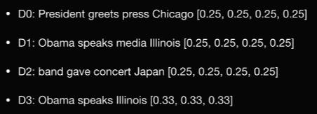
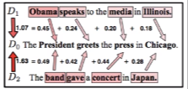
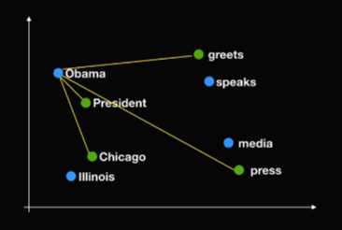
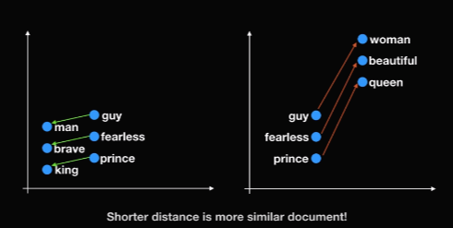
WMD algorithm (Word Mover’s Distance)
"prince fearless guy"
"king brave man"
"queen beautiful woman"

Slide 21
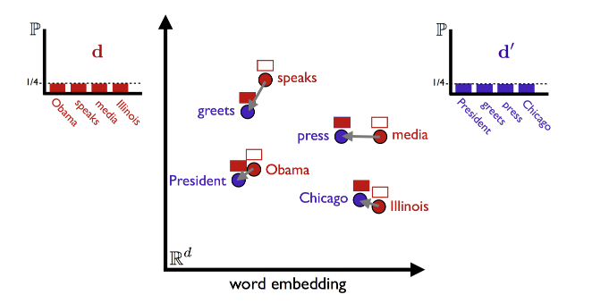
WMD algorithm (Word Mover’s Distance)
Find the minimum traveling distance
doc1의 분포를 doc2의 분포로 ‘이동’ 시키는 최적의 값을 구하는 것
보통 직접 만들기에 데이터 양이 적고,
시간적인 한계가 존재
1st try : Using pretrained word2vec model
by Google -> GoogleNews-Vectors-negative300
-SLIM(불필요한 데이터가 없고 용량이 작음)
2nd try : 영어지문 데이터로 직접 word2vec 모델을
학습시켜서 문제풀이에 적용
word2vec vector embedding

Slide 22
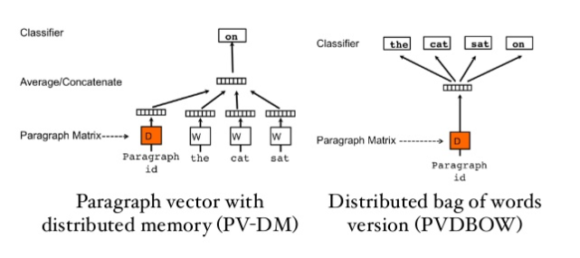
Doc2vec algorithm
Word2vec이 확장된 임베딩
PV-DBOW
이전 방식에서 나오는 context 단어들을 사용하지 않고 paragraph id 만 가지고 이 패러그래프에서 나오는 단어를 랜덤하게 예측하는 방식을 사용합니다.
input은 패러그래프 벡터이고 output은 패러그래프에서 random하게 뽑인 단어들입니다.
PV-DM
이런 paragraph vector 와 앞의 단어들을 사용해서 다음에 나오는 단어를 유추.
window라는 정해진 사이즈의 단어들을 문맥정보(context)로 사용하며 맨 앞에서부터 한 단어씩 옆으로 이동하면서 훈련 데이터로 사용합니다.
Notes:
Word2vec이 단어를 vector로 변경하는 word embedding 방식이라면 doc2vec은 문서를 vector로 변경하는 document embedding 방식입니다같은 패러그래프에서 생성된 훈련 데이터에서는 하나의 패러그래프 벡터로 공유되기 때문에 패러그래프 벡터는 훈련시 문서의 주제를 잡아주는 memory 같은 역할을 하고 있습니다. 그래서 이 알고리즘의 이름 자체가 분산화된 메모리를 가진 패러그래프 벡터(paragraph vector with distributed memory) 로 지어졌습니다.

Slide 23
각 모델의 자세한 사용방법은 코드리뷰에서!

Slide 24
픽미는 몇 등급일까?
(우리 픽미는요..)
(최고정답률기준) 등급컷
59% | 4등급
73% | 3등급..
84% | 2등급…^^
정답률
*너그러운 정답률
*더 너그러운 정답률
*유사도가 제일 높은 2개/3개의 선지 중에 정답이 있을 확률

Slide 25
+ Code Review

Slide 26
잘한 점, 아쉬운 점

Slide 27
잘한 점, 아쉬운 점

Slide 28
잘한 점, 아쉬운 점

